Slide 1
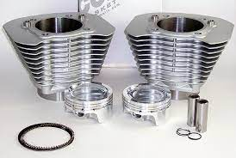
DESIGN AND ANALYSIS OF ENGINE FINS
Team Members: Roll no:
A.Sravan B19ME190L
G.Aravind B19ME192L
Vinay Pratap B19ME191L
Project Supervisor :
G.Srinu

Slide 2
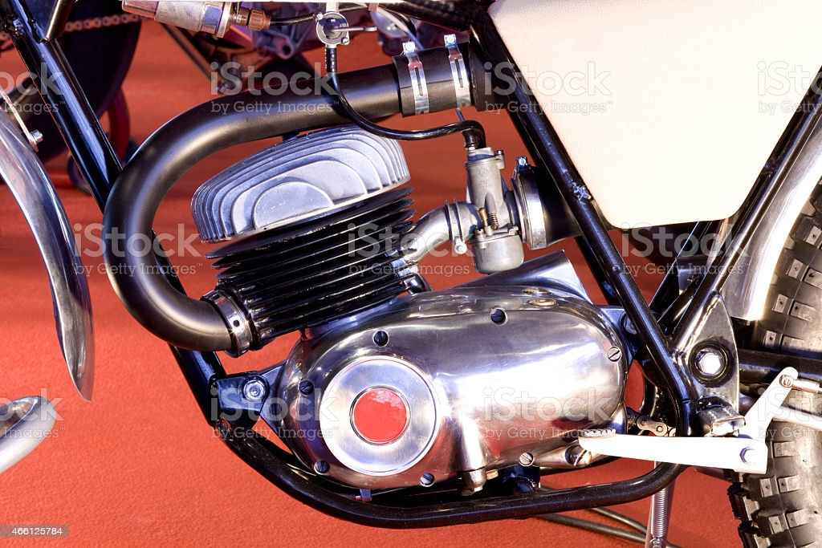
Do You Know What Is Engine Fin?

Slide 3
CONTENTS:
Abstract
Objective
Introduction of engine fins
Application
Types of fins
Theory of fin
Design model
Ansys model
Results
Conclusion
References

Slide 4
ABSTRACT:
The Engine and Reciprocating air compressor cylinder is one of the major automobile components, which is subjected to high temperature variations and thermal stresses. In order to cool the cylinder of engine, fins are provided on the surface of the cylinder to increase the rate of heat transfer. By doing thermal analysis on the cylinder fins of engine, it is helpful to know the heat dissipation inside the cylinder. We know that, by increasing the surface area we can increase the heat dissipation rate, so designing such a large complex engine is very difficult. The main aim of the project is to analyze the thermal properties by varying geometry of cylinder fins using Ansys work bench19.2 version. The 3D model of the geometries are created using CATIA V5 and its thermal properties are analyzed using Ansys workbench19.2. The variation of temperature distribution over time is of interest in many applications such as in cooling. The accurate thermal simulation could permit critical design parameters to be identified for improved life. Presently Material used for manufacturing cylinder fin body is Aluminium Alloy which has thermal conductivity of 160 – 170 W/mk. presently analysis is carried out for cylinder fins using this material.
KEYWORDS: Dissipation, Thermal conductivity, cylinder, fins,3D model, CATIA V5, Ansys.

Slide 5
OBJECTIVE:
To design the fins using CATIA V5 software.
To perform simulation using Ansys 19.2 workbench.
To get the temperature and heat flux distribution in Static Thermal Analysis.
To increase the effectiveness of cooling rate by increasing the length of fin.
To imrove the efficiency of fin by varying cross section type

Slide 6
INTRODUCTION:
The internal combustion engine is an engine in which the combustion of a fuel takes place in a combustion chamber. All two wheelers uses Air cooled engines, because Air-cooled engines are lighter weight and lesser space requirement.In Internal engine combustion engines, combustion of air – fuel mixture takes place inside engine cylinder and hot gases are produced. The temperature of gases will be around 200 – 500°C.The high temperature may result into burning of oil film between moving parts and may result into seizing or welding. Hence, this temperature must be reduced to increase the efficiency of the engine.It has been observed that the heat dissipated by fins used in engine by changing geometry and material the effectiveness may varied.

Slide 7
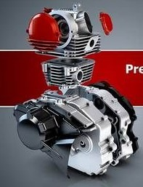
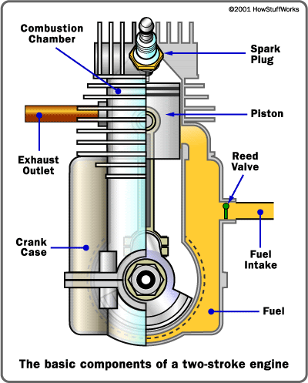
APPLICATION OF FINS:
Fins mostly used in Internal combustion engine
Fins used in 4stroke engine
Fins used in 2stroke engine

Slide 8
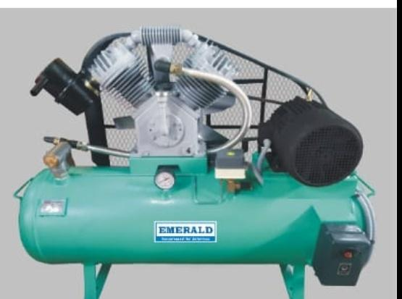
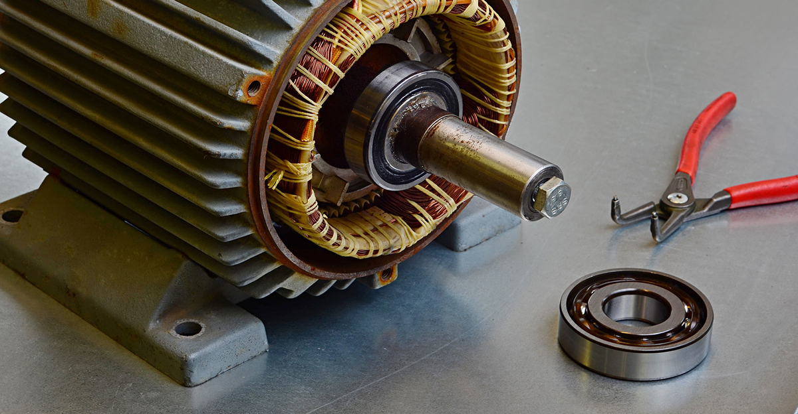
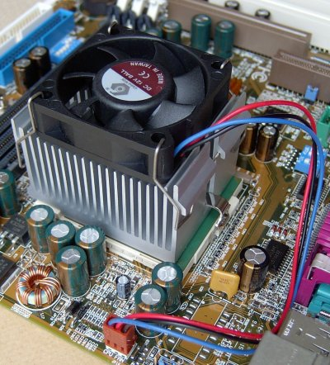

APPLICATION OF FINS:
Fins used in induction motor
Fins used in Air compressors
Fins used in heat computers
Fins used in transformer

Slide 9
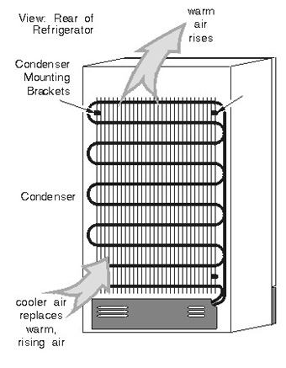
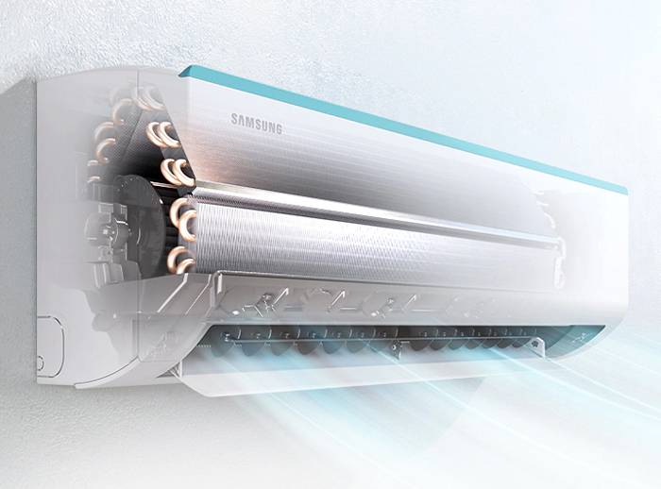
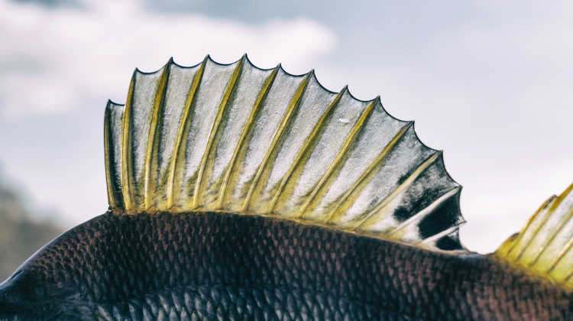
APPLICATION OF FINS:
Fins used in AC
Fins used in refregirator
Fins in nature

Slide 10
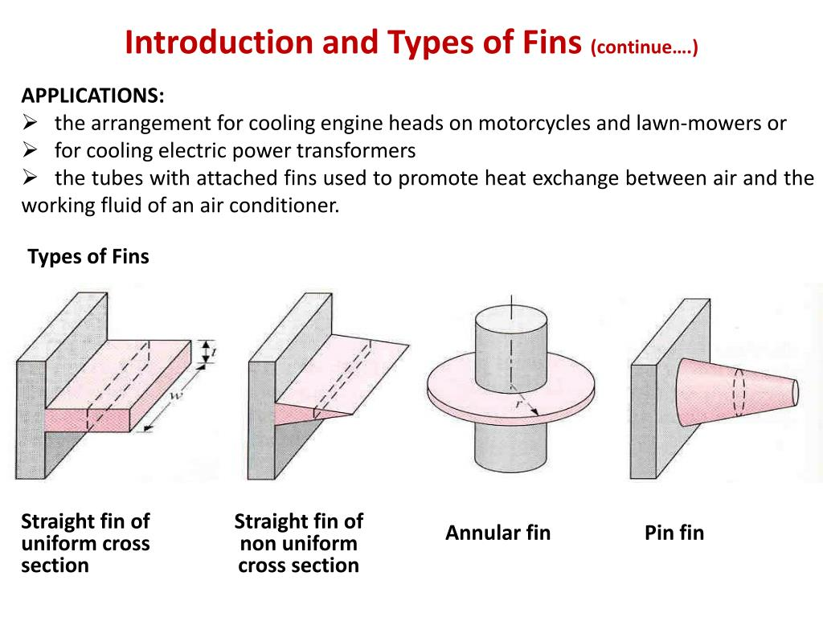
Fins are classified based on the cross section such as rectangular, circular, tapered cross section

Slide 11
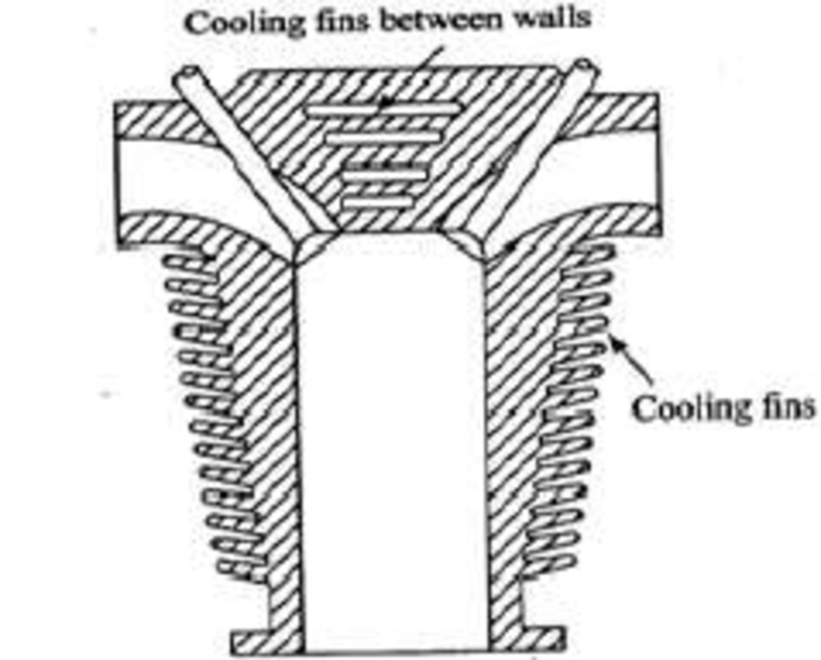
THEORY OF FIN:
AIR COOLED SYSTEM
Air cooled system is generally used Ic engines ,Air compressors, Induction motor etc. . In this system fins or (extended surfaces) are provided
on the cylinder walls, cylinder head, etc. Heat generated
due to combustion in the engine cylinder will be conducted
to the fins and Convection takes place due to air flow over
the surface of fins .
The amount of heat dissipated(convection) to air depends
upon :
(a) Amount of air flowing through the fins.
(b) Fin surface area.
(c) Thermal conductivity of metal used for fins

Slide 12
Advantages of Air Cooling System :
(a) Radiator/pump is absent hence the system is light in weight.
(b) In case of water cooling system there are leakages, but in this case of air cooling there are no leakages.
(c) Coolant and antifreeze solutions are not required in air cooling system.
(d) This system can be used in cold climates, where if water is used it may freeze.
Disadvantages of Air Cooling System:
(a) It is less efficient compared to water cooling system.
(b) Heat transfer rate is less compared to water cooling system.
(c) Not suitable for heavy diesel engine.

Slide 13
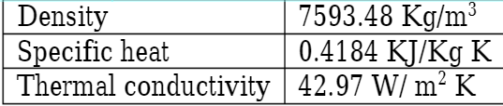
Fin Material:
Cast iron: Cast iron is basically an alloy of carbon and silicon with iron. It is containing
2.4 – 3.7 % C, 1.1 – 2.8% Si, 0.3 – 1.1% Mn, 0.16% P and 0.11% S. Cast iron possess high fluidity and hence it cast into any complex shapes and thin sections. It has an excellent wear resistance of grey iron under lubricating sliding conditions has been attributed to the presence of graphite in the micro structure. It possesses high damping capacity in addition to that cast iron is provided the working conditions clean. The material properties of cast iron are given below

Slide 14
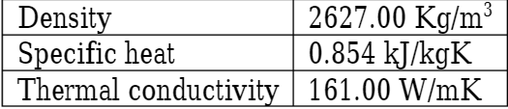
Fin Material:
ALUMINIUM:
Aluminium is a silvery white metal and it possess following characteristics:
Light metal, good conductivity, higher resistance to corrosion and very ductile. The melting point of aluminum alloy varies from 520 – 650 oC. It is common to see aluminum fins on engine cylinder and heat exchangers.
In general Aluminium is mostly used as fin material because:
It has good thermal conductivity compared to the cast iron
Aluminium is lighter in weight.
High corrosion resistance.
High surface finish.

Slide 15
MODIFICATION WE DID IN OUR PROJECT:
Fins are the extended surfaces on engine to increase the rate of heat transfer due to the convection takes place with the ambient air. There are three methods to increase the heat transfer rate :
By increasing the convection heat transfer coefficient.
By increasing the length of fin to improve the effectiveness.
By varying the material we can improve the thermal efficiency.
By changing the different cross section we can decide the highly effective type.

Slide 16
DESING AND MODELLING:
The design of engine fins done by using CATIA V5 R21 software.
CATIA is a Computer Aided Three dimensional Interactive Application. It is a solid modelling tool that unites the 3D parametric features to 2D tools and also addresses every design to manufacturing process. Catia provides the capaboility to visualise design in 3D.
Steps involved in design of fins using CATIA:
Draw the individual components of the part in 2D using draw command.
Set the dimensions for each line using dimensions command.
Convert the 2D sketch to 3D using pad command.
Make the holes using pocket command.
Set the material as aluminium using material command.
Assemble the individual components in the part drawing.

Slide 17
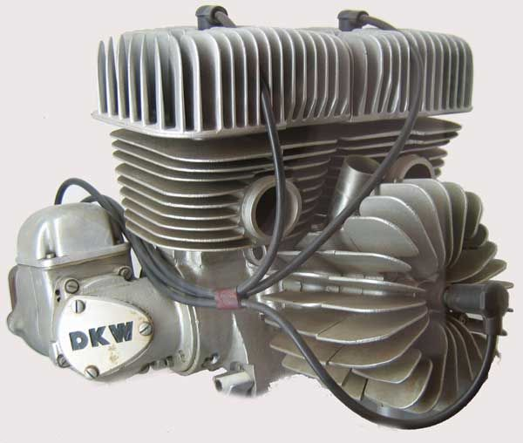
SPECIFICATIONS OF DESIGN:
Engine type: Kawasaki KX 450CC engine
Bore: 80mm
Stroke: 90mm
Compression Ratio:12.8 : 1
Fin length: max 60mm & min 5mm
Fin thickness: 3mm
Fin type: rectangular fin with curved edges

Slide 18
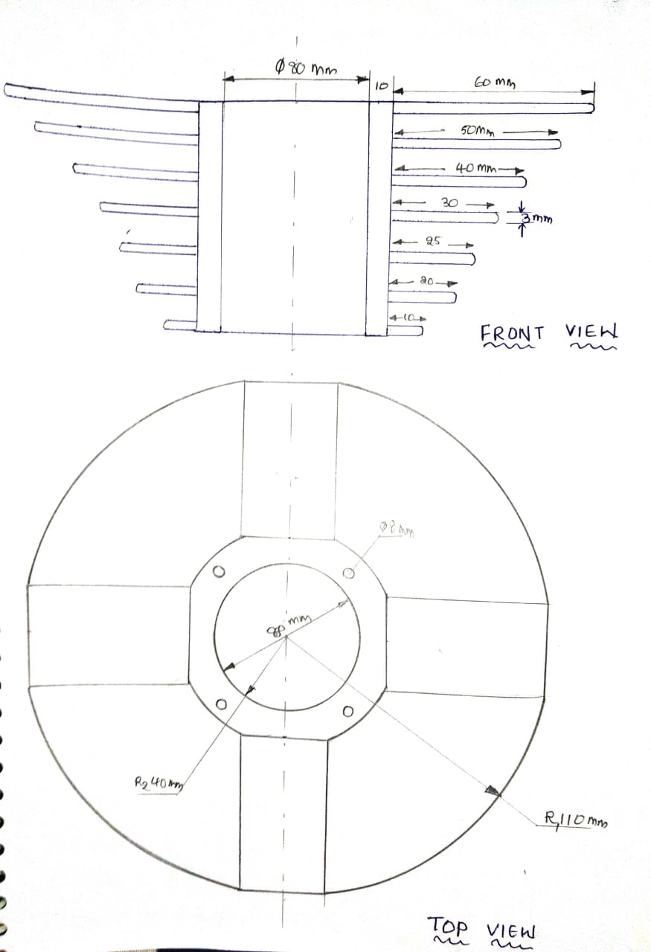
DRAWINGS BEFORE MODELLING:

Slide 19
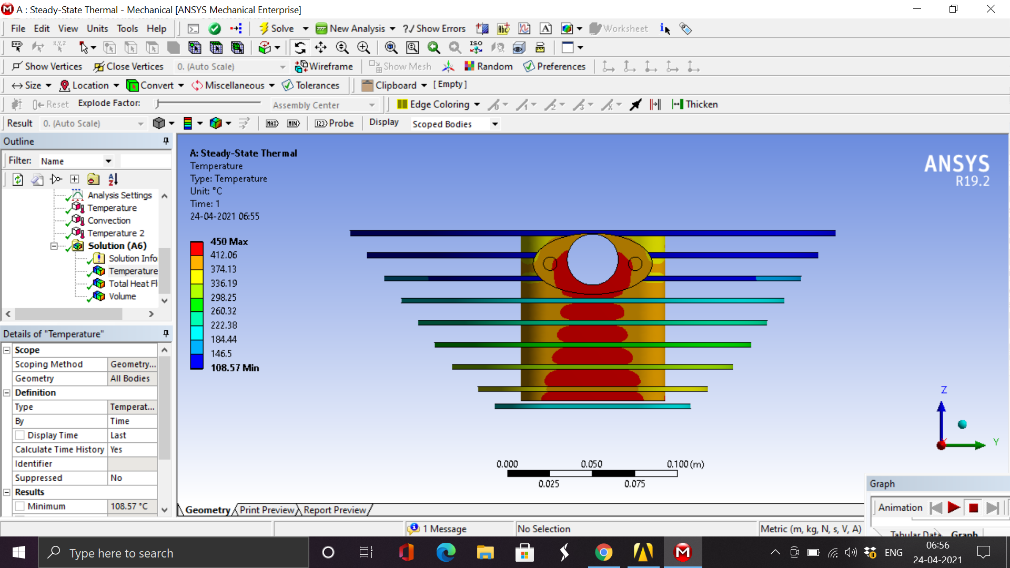
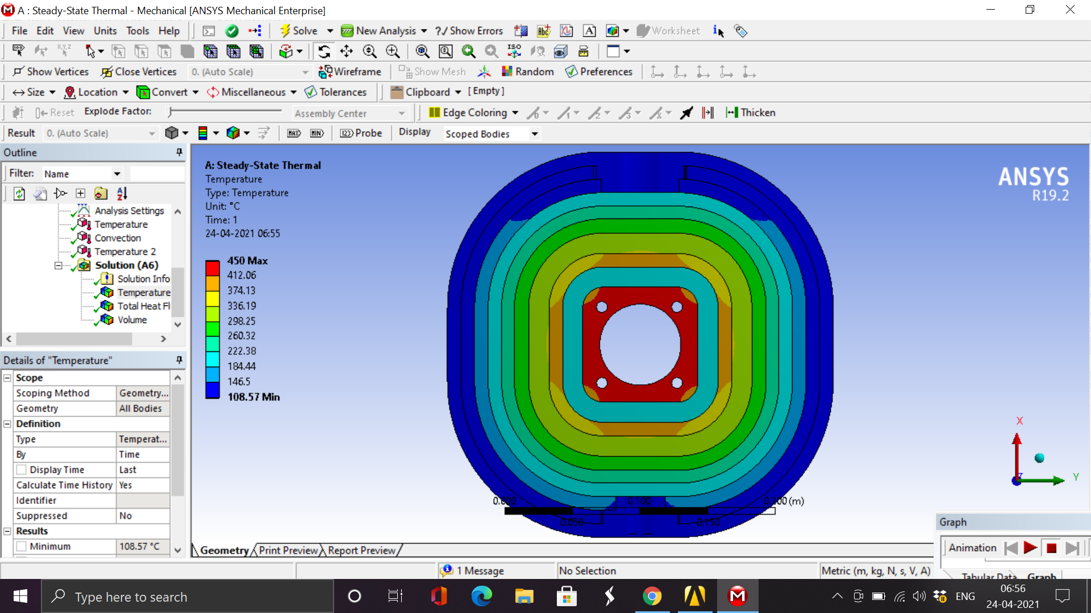
DESIGN MODELS IN CATIA:
Straight vertical fins design

Slide 20
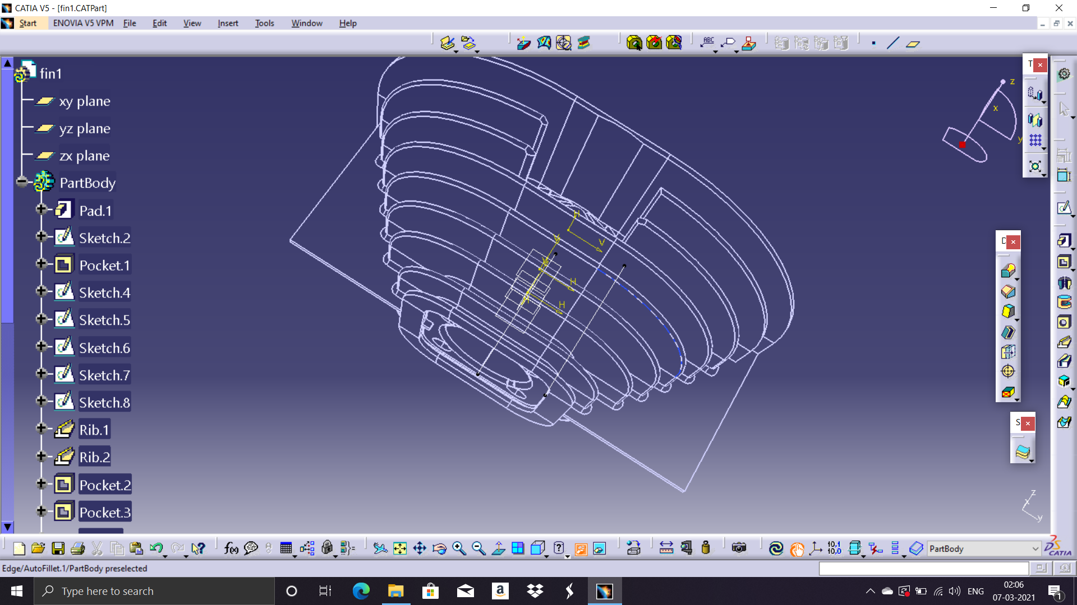
DESIGN MODELS IN CATIA:
Modified fin design

Slide 21
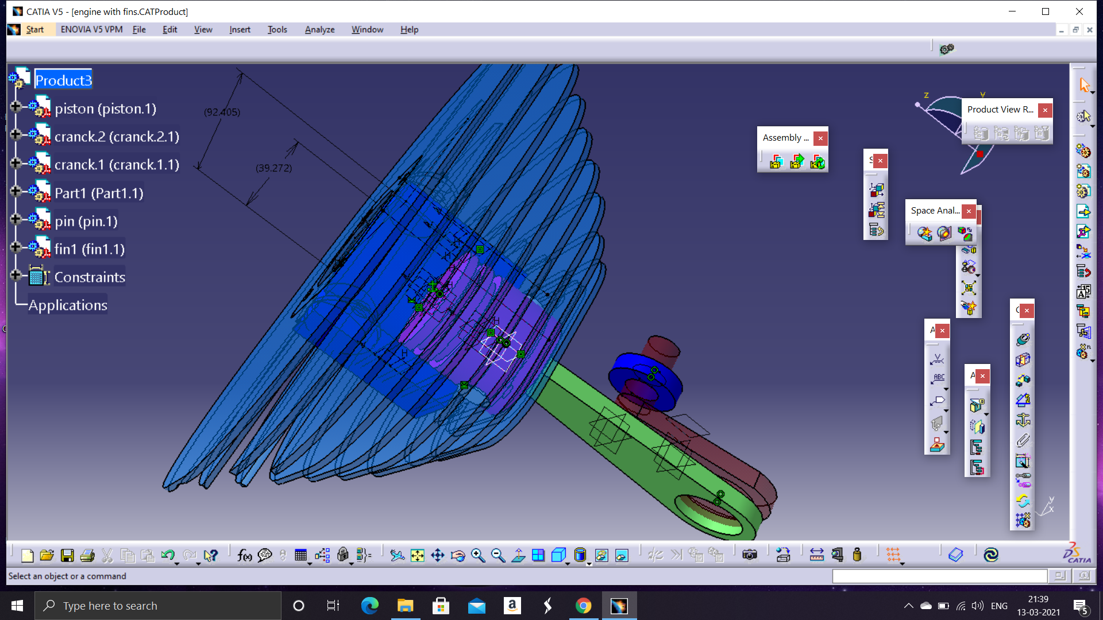
DESIGN MODELS IN CATIA:
Design of fins with piston cylinder arrangement

Slide 22
STATIC THERMAL ANALYSIS:
Thermal static analysis is done by using Ansys 19.2 software.
ANSYS: Ansys 19.2 is an advanced simulation software where we can do different analysis such as static analysis, dynamic analysis, fluid flow analysis, themal analysis etc..
Steps involved in Static thermal analysis:
Engineering data
Geometry
Model
Meshing
Analysis
Results

Slide 23
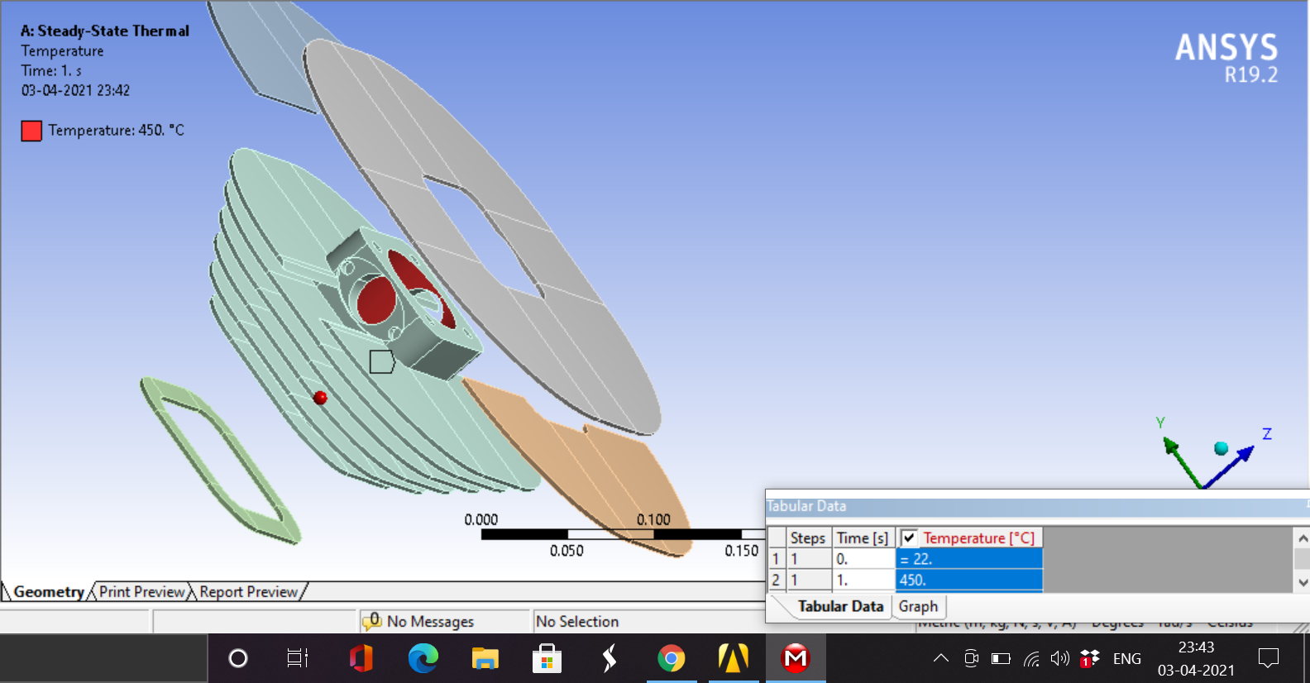
MODEL:

Slide 24
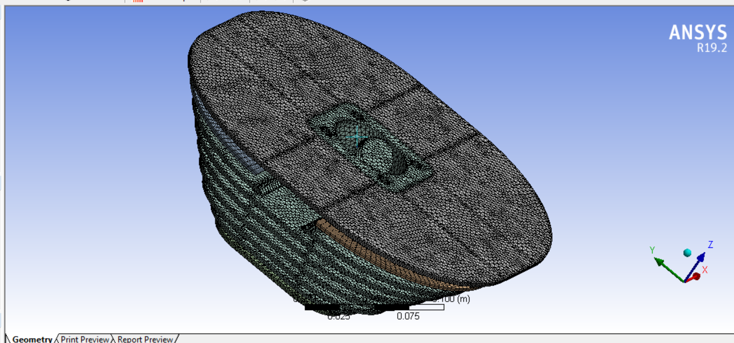
MESHING:

Slide 25
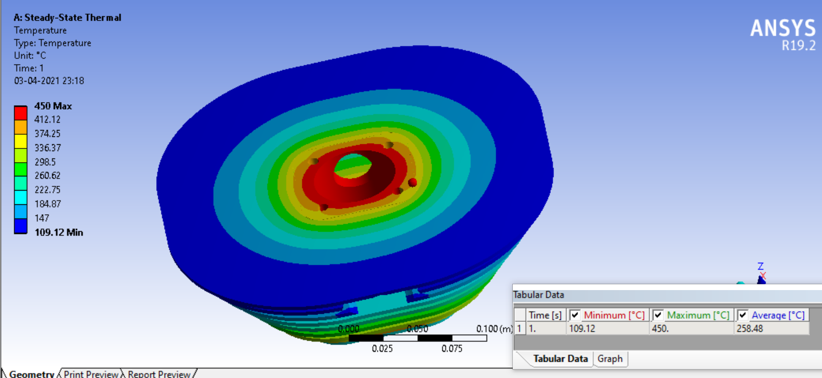
TEMPERATURE ANALYSIS:

Slide 26
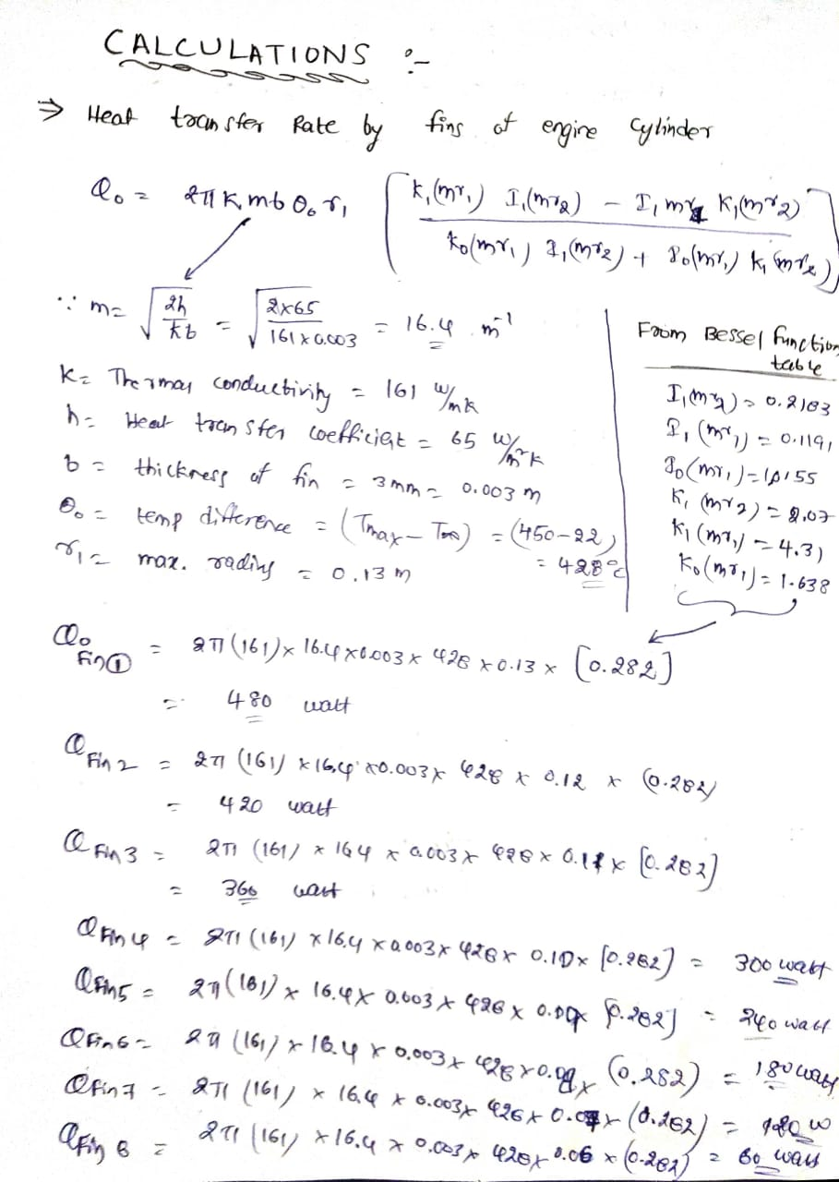
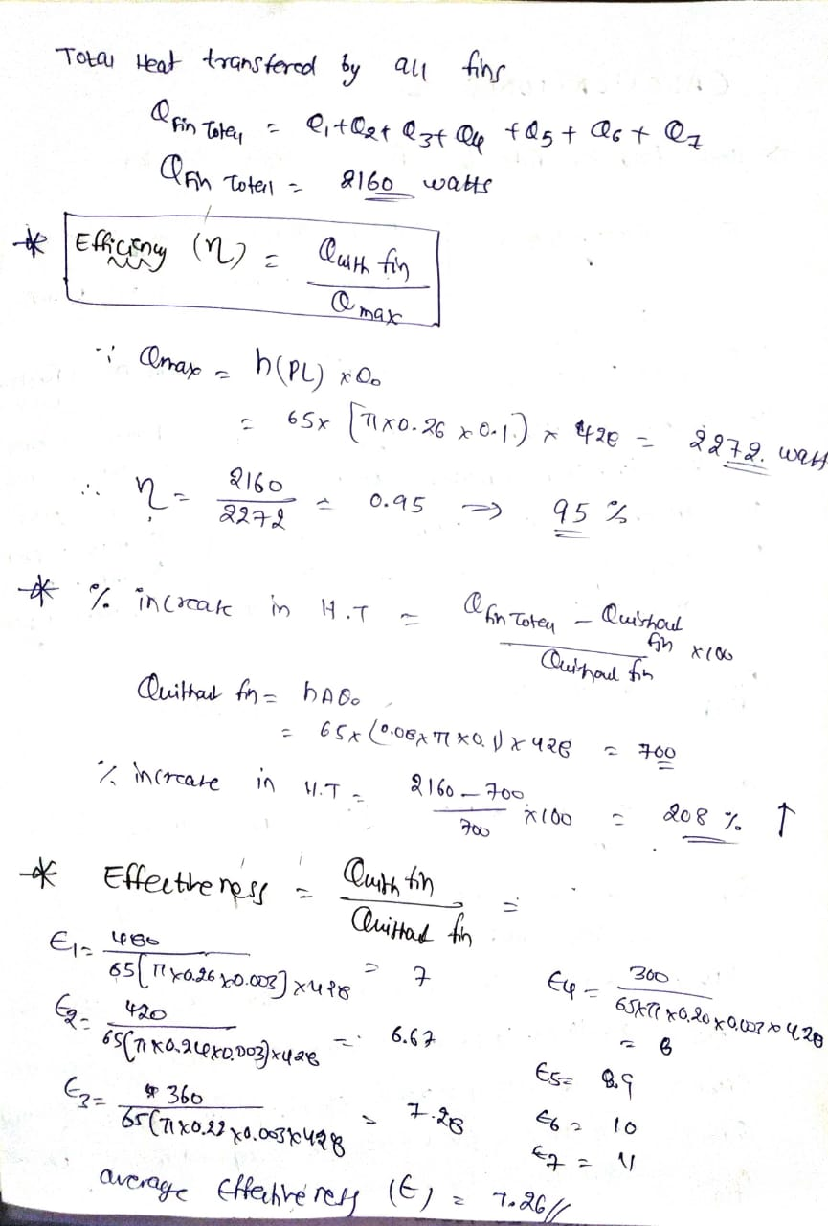

Slide 27
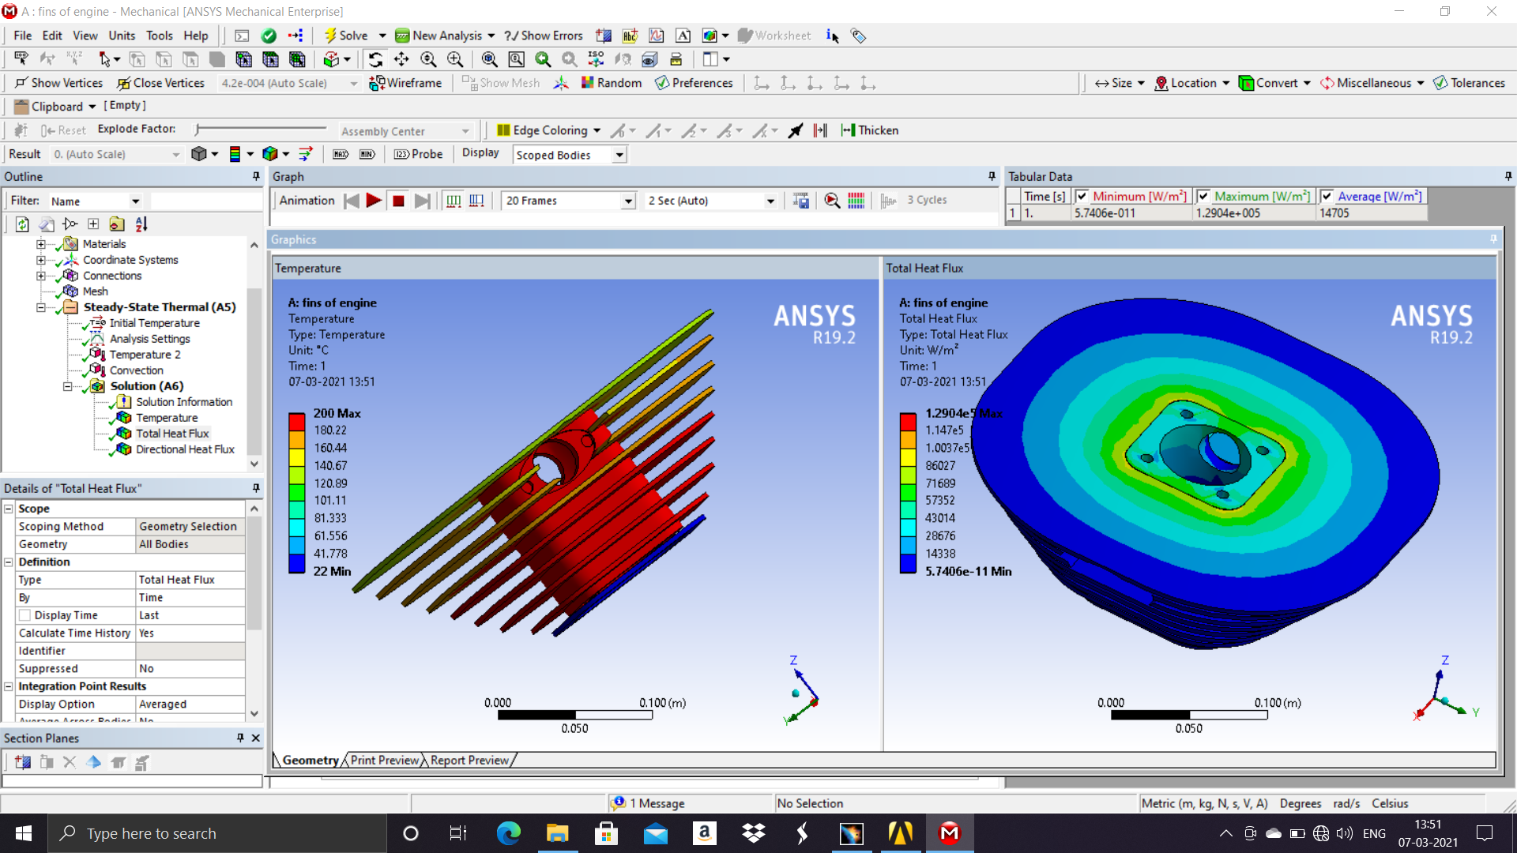
HEAT FLUX ANALYSIS:

Slide 28
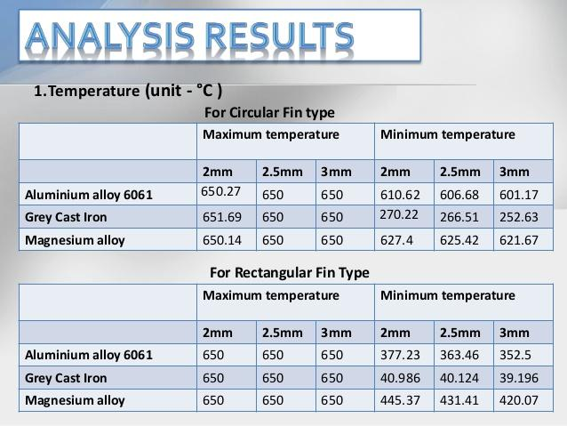
RESULTS OBTAINED:

Slide 29
CONCLUSION:
New Modern high efficient fins are designed using CATIA V5.
Temperatures at different locations are obtained by ansys 19.2 workbench.
Heat flux distribution at different locations obtained in the ansys 19.2
The effectiveness and efficiency of different fins calculated by varying the c/s and materials.

Slide 30
REFERENCES:
G. Ganesh Kumar, K. Sridhar, and B. Anil Kumar, (2015) “Experimental Studies on Conjugate mixed Convection Heat Transfer Through Perforated Fins”, International Journal of Science, Engineering and Technology Research, pp. 1803-1808, E-ISSN: 2278 – 7798.
J. G. Bartas and W. H. Sellers," Radiation Fin Effectiveness," JOURNAL OF HEAT TRANSFER , TRANS. ASME , Serie s C , vol. 82 , no . 1. Feb., 1960, p. 73.
J. G. Bartas and W. H. Sellers," Radiation Fin Effectiveness," JOURNAL OF HEAT TRANSFER , TRANS. ASME , Serie s C , vol. 82 , no . 1. Feb., 1960, p. 73.
D. B. MacKay and E. L. Leventhal, "Radiant Heat Transfer From a Flat Plate Uniformly Heated Along One Edge," North American Aviation, Inc., Report M D 58-187, August, 1958.
J. E. Wilkins, Jr., "Minimizing the Mass of Thin Radiating Fins," Journal of Aeronautical Sciences, vol. 27, no. 2, Feb., 1960, p. 145.
E. N. Nilson and It. Curry, "The Minimum Weight Straight Fin of Triangular Profile Radiating to Space," Journal of Aeronautical Sciences, vol. 27, no. 2, Feb., 1960, p. 146.
J. E. Wilkins, Jr., " Minimum Mass Thin Fins Which Transfer Heat Only by Radiation to Surroundings at Absolute Zero," J. Soc. Indust. and Appl Math., Dec., 1960.

